Slide 1
Programming pradgism - Functional programming -
Record & type parameter

Slide 2
1. Algebra type
data Bool = False | True
type name
Constructor (different with OOP)

Slide 3
1. Algebra type
data Shape = Circle Float Float Float | Rectangle Float Float Float Float

Slide 4
2. Record syntax
data Person = Person String String Int deriving (Show)
data Person = Person {
firstName :: String,
lastName :: String,
age :: Int
} deriving (Show)
Record syntax

Slide 5
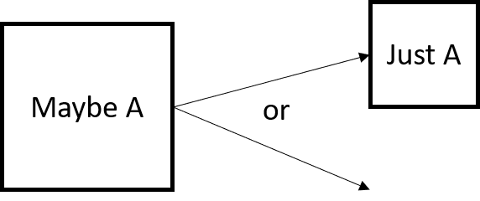
3. Type parameter (very important!)
Consider type Maybe
data Maybe a = Nothing | Just a
Specific type
Type constructor

Slide 6
4. Abstract type
data Car = Car {
company :: String,
model :: String,
year :: Int
} deriving (Show)
data Car a b c = Car {
company :: a,
model :: b,
year :: c
} deriving (Show)

